Slide 1

RV College of Engineering
Go, change the world
Student Result System
1RV21MC029
Chandana M
Under the Guidance
of
Dr Renuka Prasad B
Associate Professor
R V College of Engineering
26 May,2023
Department of MCA, RVCE

Slide 2

Go, change the world
RV College of
Engineering
Agenda
Introduction
Literature Survey
Objectives of the Project Work
Proposed Methodology
Training Details
Work Progress
References

Slide 3
Go, change the world
RV College of
Engineering
Introduction
Increasing volume of student data and the need for a more efficient system to handle and manage it. Desire to provide personalized and secure access to result information for students
EdTech refers to the use of technology to enhance teaching, learning, and administrative processes in education. The project focuses on improving the result management process in educational institutions using technology
Includes individual marks or grades obtained by students in different subjects and examinations.

Slide 4
Go, change the world
RV College of
Engineering
Introduction
Utilizes Node.js, Express, MySQL, and React to create a comprehensive result management system. Automates result management tasks and improves efficiency. Provides a user-friendly interface for students and administrators
Simplifies result management for administrators, promoting efficiency in educational institutions

Slide 5
Go, change the world
RV College of
Engineering
Literature Survey
S No | Author and Paper title | Details of Publication | Summary of the Paper
1 2 | Anuraj Singh, Vishwas Singh Kushwaha Result Publishing System Using Asymmetric Key Encryption Salahudin Robo, Djoko Budiyanto Setyohadi, Albertus Joko Santoso An Identification of Success of Academic System Application Using Delone and McLean Design (Case Study at Wira Husada School of Health Science Yogyakarta) | 2022 IEEE 6th Conference on Information and Communication Technology (CICT) 2018 International Conference on Information and Communications Technology (ICOIACT) | This blockchain-based web app secures bulletin board result declaration by ensuring confidentiality, authenticity, and preventing grade manipulation. Only registered students can access the results, and the use of blockchain technology prevents tampering or misuse of grades. This research assesses the success factors of the academic information system at Wira Husada School of Health Science, identifying variables such as information quality, system quality, service quality, user satisfaction, and their impact on the system's net benefit.

Slide 6
Go, change the world
RV College of
Engineering
Literature Survey
S No | Author and Paper title | Details of Publication | Summary of the Paper
3 4 | Mr. Santosh B Akki, Dr. Vijayalakshmi M Design of Dashboard for University Examination Result Analysis System Arilla Nurmoslim, Taufik Hidayat, Sarah Khoirunnisa, Tanty Oktavia, Natalia Limantara Student Performance Indicator Monitoring Systems: A Case Study ABC University | 3rd IEEE International Conference on Computational Systems and Information Technology for Sustainable Solutions 2018 2018 International Conference on Information Management and Technology (ICIMTech) | This paper presents a dashboard system for analyzing university examination results, providing efficient decision-making support through self-explanatory visual reports and streamlined analysis of college, course, and subject-wise performance. This study creates a web-based student performance monitoring system for ABC University, resolving data availability and timeliness challenges. It enables real-time monitoring and analysis of performance indicators, improving the efficiency of performance assessment.

Slide 7
Go, change the world
RV College of
Engineering
Literature Survey
S No | Author and Paper title | Details of Publication | Summary of the Paper
5 6 | Karishma Khan, Janhavi Patil, Nagma Shaikh, Amaan Thakur, Dr. Zainab Pirani Analysis of Intelligent System for Student’s Performance using E-learning Approach Dalal Nemenqani, Rasha Soliman, Merajuddin AhmedStudent Performance Indicator Submission of Exams and Result Analysis (SERA) Software as a new tool in Medical Education | International Conference on Smart Systems and Inventive Technology (ICSSIT 2018) 2021 International Conference of Women in Data Science at Taif University | This paper analyzes online multiple-choice test data to enhance student performance through feedback, identifying strategies and correct guesses. It aims to improve the testing system and expand knowledge for students and test-makers This paper presents the development and implementation of SERA (Submission of Exams and Result Analysis) software for medical education. It addresses educators' needs, integrates various tasks, and includes a satisfaction survey among staff and unit members.

Slide 8
Go, change the world
RV College of
Engineering
Literature Survey
S No | Author and Paper title | Details of Publication | Summary of the Paper
7 8 | Salahudin Robo, Djoko Budiyanto Setyohadi, and Albertus Joko Santoso An Identification of Success of Academic System Application Using Delone and McLean Design Haoyang Li, Wenxuan Li, Zihao Zhang, Haobo Yuan, Yunxiang Wan Machine learning analysis and inference of student performance and visualization of data results based on a small dataset of student information. | 2021 12th International Conference on Computing Communication and Networking 2021 International Conference of Women in Data Science at Taif University (WiDSTaif). | A cost-effective solution to slow result servers in Bangladesh involves encrypting results using symmetric key cryptography and sending them to students' email addresses. This paper utilizes machine learning algorithms to predict student performance based on pre-processed student information data.

Slide 9
Go, change the world
RV College of
Engineering
Literature Survey
S No | Author and Paper title | Details of Publication | Summary of the Paper
9 10 | Tamanna Rahaman, Md. Muktar Hossain, Fahmida Haque Mim, Farah Wahida Privacy Preserving Publication of Educational Data Ukaoha, Kingsley Chiwuike and Amadin, Iwebuke Frank Computerized Result Processing System for the Department of Computer Science | 2021 International Conference on Automation, Control and Mechatronics for Industry 4.0 (ACMI) 2019 IEEE 6th International Conference on Adaptive Science & Technology (ICAST) | This paper addresses data privacy concerns in online publication, specifically for educational data. It compares educational data with transactional data and proposes modifications to enhance privacy preservation. This paper presents a Computerized Results Processing System (CRPS) for the Department of Computer Science at the University of Benin, offering timely and accurate result processing. It has been piloted and can be adapted to other institutions, with initial setup costs and training as potential drawbacks.

Slide 10
Go, change the world
Summary of the literature survey
The literature survey focuses on the design and implementation of a Dashboard for University Examination Result Analysis System
The system aims to simplify and enhance decision-making support by presenting analytical visual dashboard reports
It improves the analysis of university examination results by considering key performance indicators and providing granularity in result analysis
The system helps in faster and accurate analysis of college, course, and subject-wise performance
It combines multiple traditional reports into a single dashboard, making the analysis more effective and efficient
The study emphasizes the importance of data analysis and visualization in improving the examination management system
The dashboard software can be utilized by educational institutions to monitor student performance and make data-driven decisions

Slide 11
Go, change the world
RV College of
Engineering
Objectives
Rebuild the existing PHP-based student result system using Node.js, Express, MySQL, and React
Improve the efficiency and effectiveness of the result management process in educational institutions
Enhance user-friendliness and accessibility for both students and administrators.
Enable students to easily view their individual marks or grades across different subjects and examinations
Ensure personalized and secure access to result information based on student details (such as USN, semester, and department)
Simplify administrative tasks such as uploading mark sheets and managing subjects and departments

Slide 12
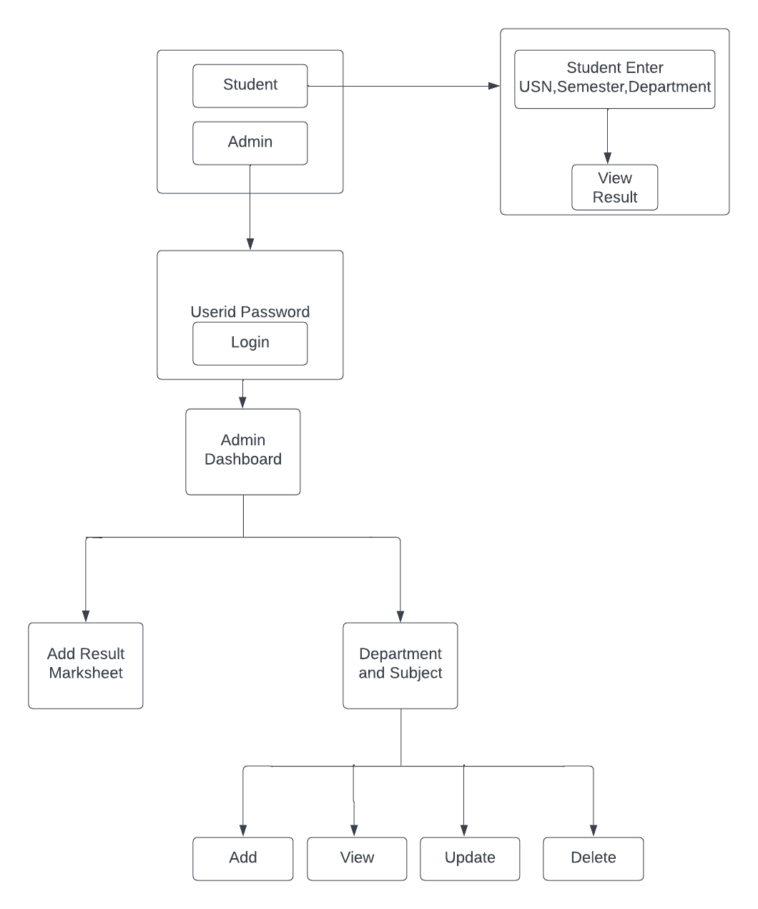
Go, change the world
RV College of
Engineering
Proposed Methodology

Slide 13
Go, change the world
The learning of Tools and Technologies:
  Node.js is a runtime environment that allows you to run JavaScript on the server-side
  Express is a popular web application framework for Node.js. It provides a set of features and tools for building web applications and APIs
  React is a JavaScript library for building user interfaces. It allows you to create reusable UI components and efficiently update the user interface when the underlying data changes
  Courses Undertaken:
  Node.js and Express - freeCodeCamp
RV College of
Engineering
Training / Courses Undertaken

Slide 14
Go, change the world
RV College of
Engineering
Future work
Single Marksheet Upload: Develop a feature that allows the admin to upload a single marksheet file containing student grade information.
Data Parsing and Mapping: Parse the uploaded marksheet file and extract relevant data such as student details, subject codes, and corresponding marks. Map the extracted data to the appropriate database fields for storage
Implement CRUD operations for the admin to manage department and subject details, allowing them to add, edit, and delete information with proper data validation and error handling
Implement a feature to display the student's individual result, including subject-wise marks or grades, overall SGPA.

Slide 15
Go, change the world
RV College of
Engineering
Future work
Single Marksheet Upload: Develop a feature that allows the admin to upload a single marksheet file containing student grade information.
Data Parsing and Mapping: Parse the uploaded marksheet file and extract relevant data such as student details, subject codes, and corresponding marks. Map the extracted data to the appropriate database fields for storage
Implement CRUD operations for the admin to manage department and subject details, allowing them to add, edit, and delete information with proper data validation and error handling.
Implement a feature to display the student's individual result, including subject-wise marks or grades, overall SGPA , and any additional performance metrics.

Slide 16
Go, change the world
RV College of
Engineering
References
[1] Anuraj Singh, Vishwas Singh Kushwaha -Result Publishing System Using Asymmetric Key Encryption - 2022 IEEE 6th Conference on Information and Communication Technology (CICT)
[2] Salahudin Robo, Djoko Budiyanto Setyohadi, Albertus Joko Santoso - An Identification of Success of Academic System Application Using Delone and McLean Design - 2018 International Conference on Information and Communications Technology (ICOIACT)
[3] Mr. Santosh B Akki, Dr. Vijayalakshmi M - Design of Dashboard for University Examination Result Analysis System - 3rd IEEE International Conference on Computational Systems and Information Technology for Sustainable Solutions 2018
[4] Arilla Nurmoslim, Taufik Hidayat, Sarah Khoirunnisa, Tanty Oktavia, Natalia Limantara - Student Performance Indicator Monitoring Systems: A Case Study ABC University - 2018 International Conference on Information Management and Technology (ICIMTech)

Slide 17
Go, change the world
RV College of
Engineering
References
[5] Karishma Khan, Janhavi Patil, Nagma Shaikh, Amaan Thakur, Dr. Zainab Pirani -Analysis of Intelligent System for Student’s Performance using E-learning Approach - International Conference on Smart Systems and Inventive Technology (ICSSIT 2018)
[6] Dalal Nemenqani, Rasha Soliman, Merajuddin Ahmed - Student Performance Indicator Submission of Exams and Result Analysis (SERA) Software as a new tool in Medical Education - 2021 International Conference of Women in Data Science at Taif University
[7] Salahudin Robo, Djoko Budiyanto Setyohadi, and Albertus Joko Santoso - An Identification of Success of Academic System Application Using Delone and McLean Design - 2021 12th International Conference on Computing Communication and Networking

Slide 18
Go, change the world
RV College of
Engineering
References
[8] Haoyang Li, Wenxuan Li, Zihao Zhang, Haobo Yuan, Yunxiang Wan - Machine learning analysis and inference of student performance and visualization of data results based on a small dataset of student information - 2021 International Conference of Women in Data Science at Taif University (WiDSTaif)
[9] Tamanna Rahaman, Md. Muktar Hossain, Fahmida Haque Mim, Farah Wahida - Privacy Preserving Publication of Educational Data - 2021 International Conference on Automation, Control and Mechatronics for Industry 4.0 (ACMI)
[10] Ukaoha, Kingsley Chiwuike and Amadin, Iwebuke Frank - Computerized Result Processing System for the Department of Computer Science - 2019 IEEE 6th International Conference on Adaptive Science & Technology (ICAST)

